Slide 1
Implementation of a Manufacturing Execution System for a Learning Factory
By
Mattis Tom Ritter

Slide 2
Content Title
Introduction
Problem Statement and Objectives
Manufacturing Execution System
Fischertechnik Learning Factory
Results and Discussion
Concussion and Recommendations

Slide 3

Introduction
Digitization is a main pillar of Industry 4.0
Data is the most valuable resource of a company
Manufacturing Execution System enables to unlock this value

Slide 4

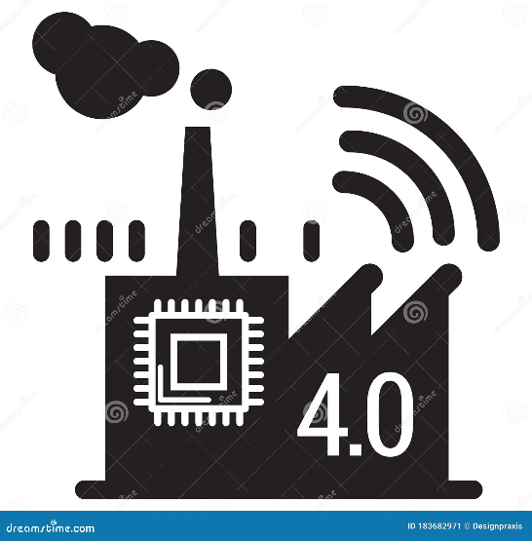
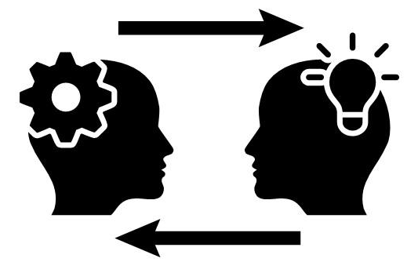
Problem Statement and Objectives
Companies
Undigitized
Lack of Skills and Mindset
Knowledge Transfer
Learning Factory
Demonstrator
Implementation
Shows Benefits

Slide 5
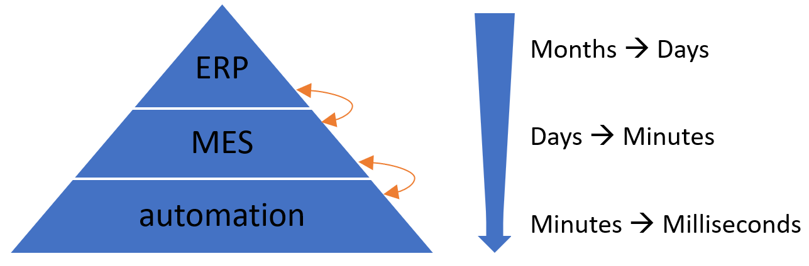



Manufacturing Execution System

Slide 6
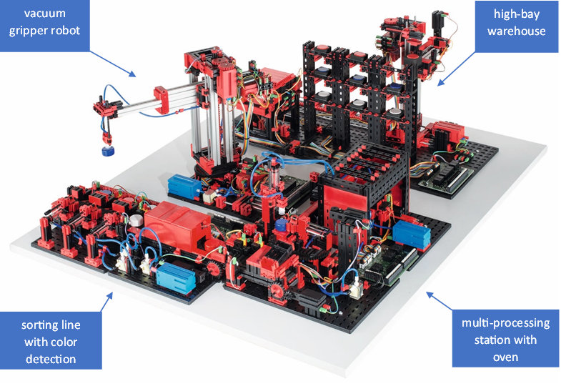
Fischertechnik Learning Factory

Slide 7
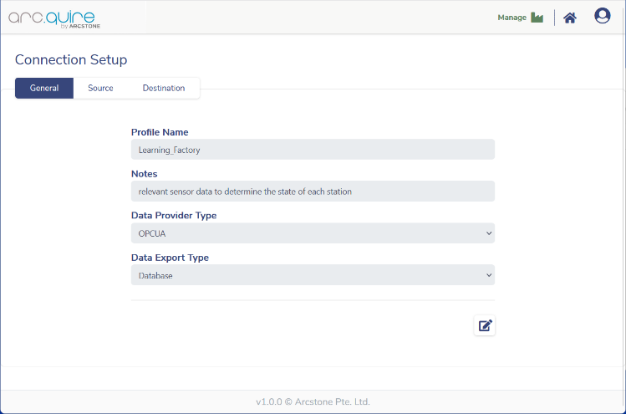
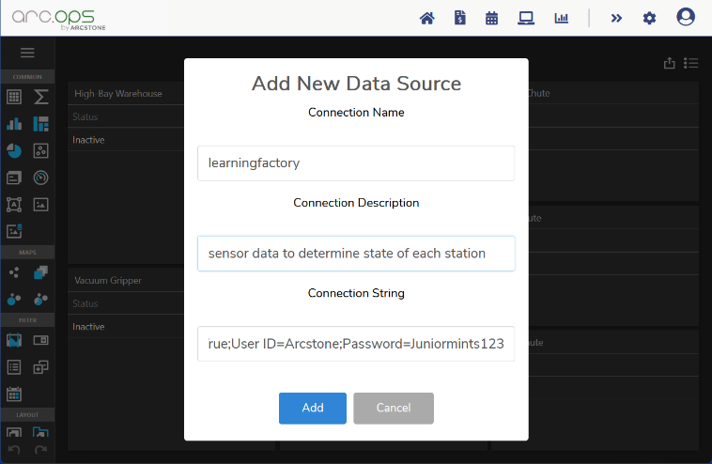
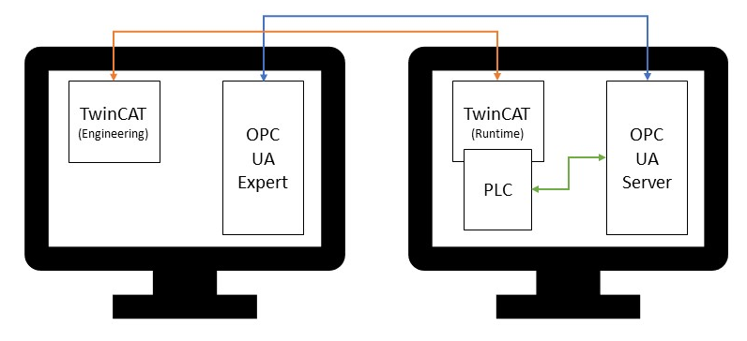
Results and Discussion

Slide 8
Results and Discussion

Slide 9
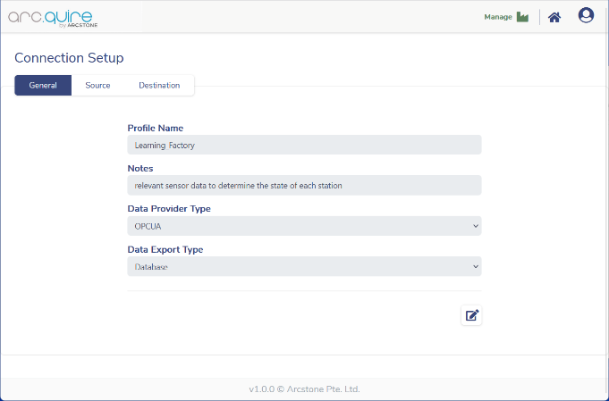

Results and Discussion

Slide 10
Results and Discussion

Slide 11
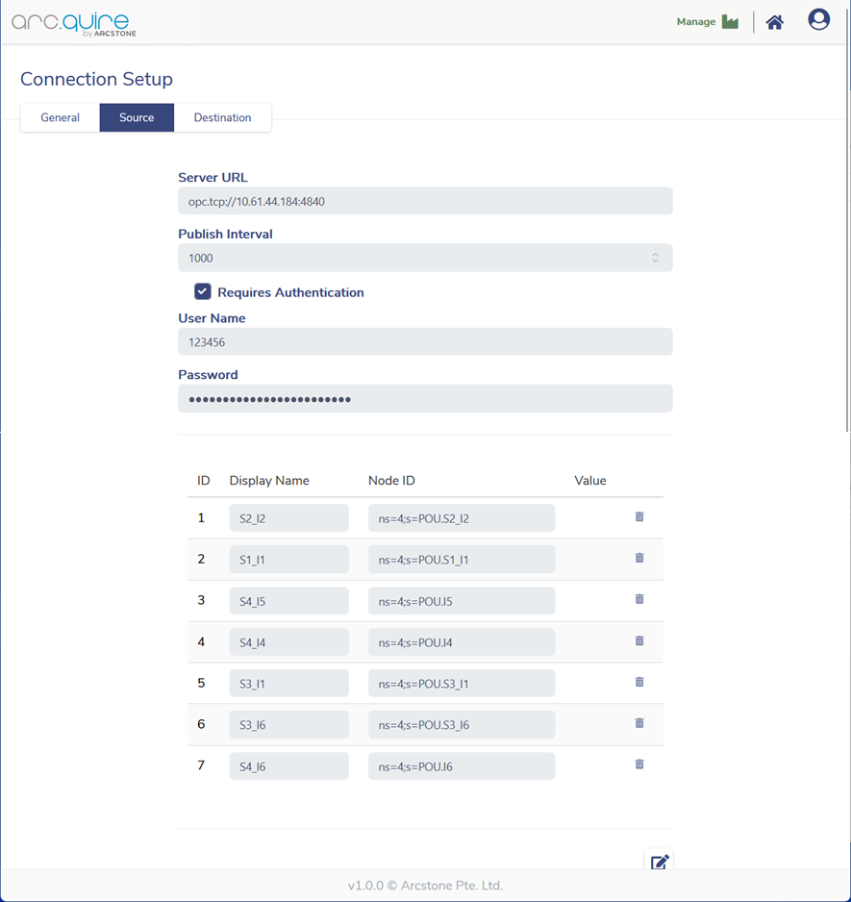
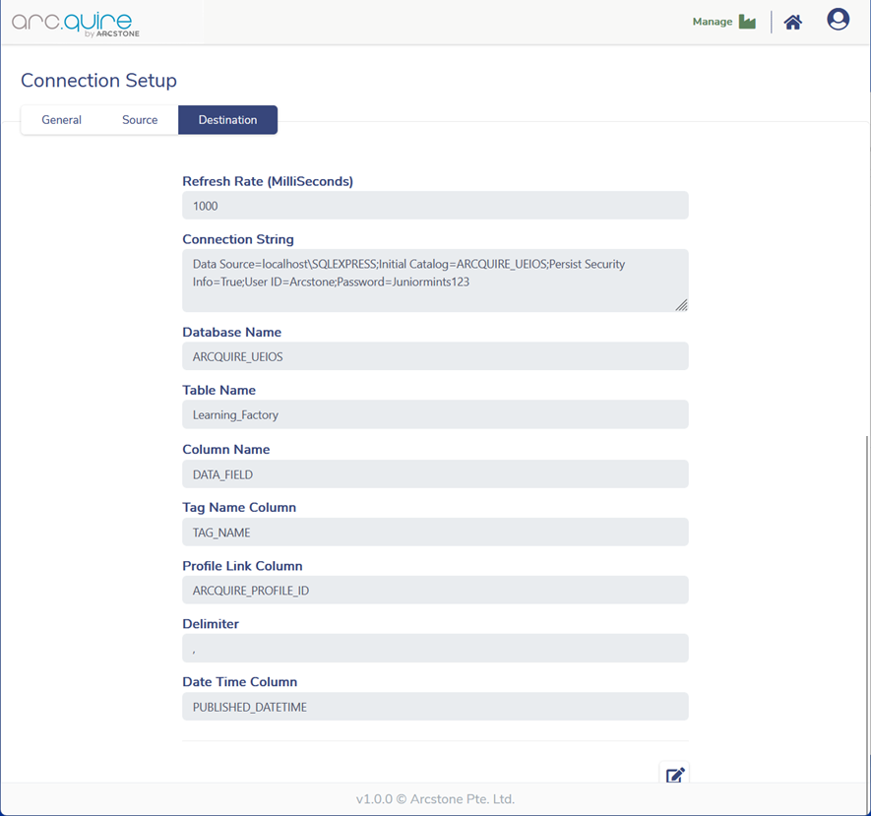
Results and Discussion

Slide 12
Results and Discussion

Slide 13
Results and Discussion

Slide 14
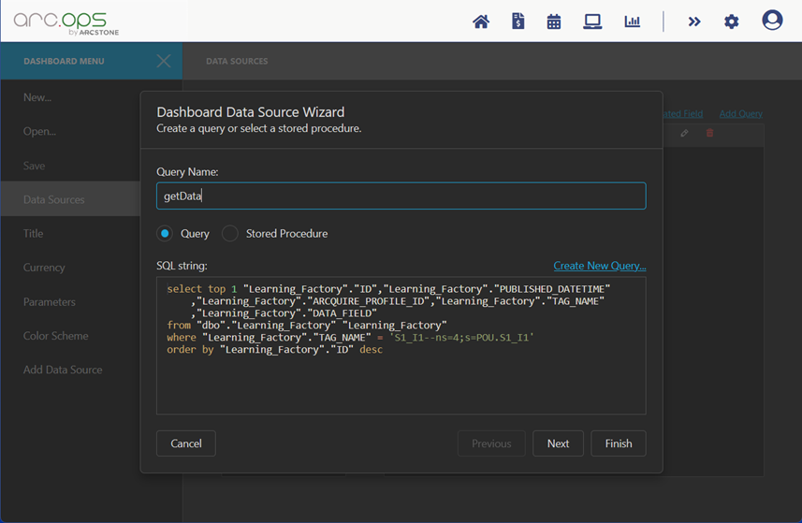
Results and Discussion

Slide 15
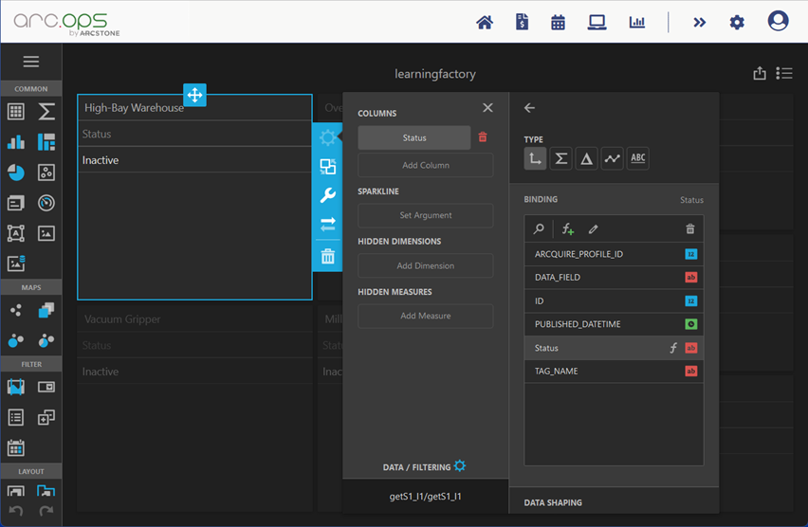
Results and Discussion

Slide 16
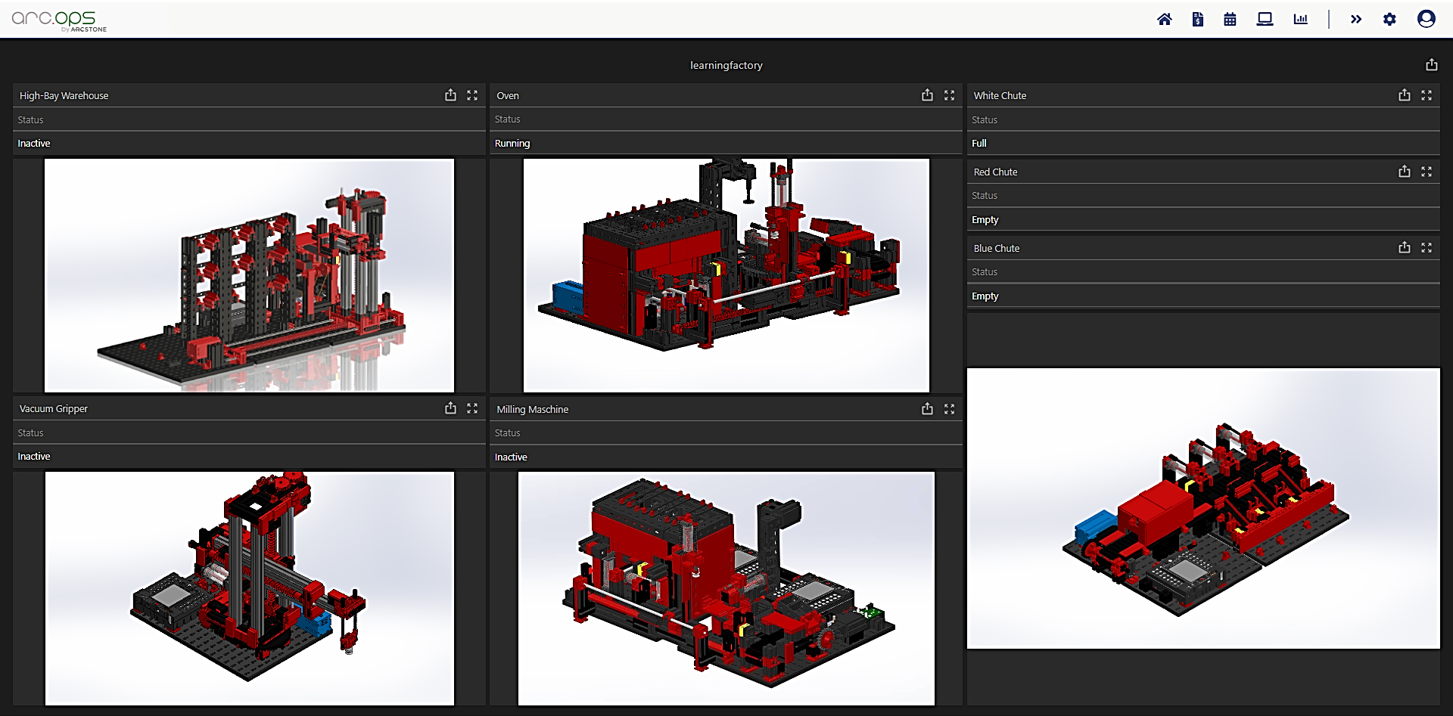

Slide 17
Concussion and Recommendations
Implementation was successful
Most functionalities of a MES are covered
Benefits can be demonstrated
Establish more features of MES
Build on foundation to bring simulation further to Industry 4.0

Slide 18


Terima kasih

